Slide 1
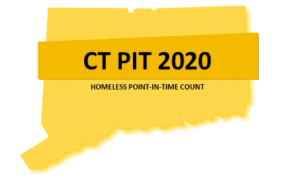
2020 Housing
Inventory Training
Mike Apotsos Linda Casey Jim Bombaci Research Analyst Dir. HMIS & Strat. Analysis VP of Operations
CCEH CCEH Nutmeg Consulting, LLC
The webinar will begin shortly
Think Change • Be Change • Lead Change

Slide 2
Agenda for Today
Housing Inventory Counts
Data Entry for the Bed Count Only (HIC)
Demonstration of the PIT App Database https://app.nutmegit.com/HMISPortal
For today it’s all about the beds, not the people!
Think Change • Be Change • Lead Change

Slide 3
Overview
According to HUD:
The Housing Inventory Count (HIC) is a point-in-time inventory of provider projects within a Continuum of Care that provide beds and units dedicated to serve persons who are homeless, categorized by six Project Types: Emergency Shelter; Transitional Housing; Rapid Re-housing; Safe Haven; Permanent Supportive Housing; and Other Permanent Housing
Think Change • Be Change • Lead Change

Slide 4
Housing Inventory Counts
Why we do this: This informs HUD of the capacity to meet the needs of people experiencing homelessness in your CoC
It’s the “other part” of the Point-in-Time count process that includes updating the Housing Inventory for every area
This includes shelters, transitional housing projects, permanent supportive housing, other permanent housing, and rapid re-housing projects
The process for this will again be coordinated through an online data entry program where every agency updates the project capacity and total people served on the night of the count
Regional Coordinators work with CoC Leadership, providers, CCEH, and Nutmeg to be sure all projects are correctly identified and all new, under development, and closed projects are properly accounted for on the HIC
Think Change • Be Change • Lead Change
Notes:
The Housing Inventory Count informs and Updates the Housing Inventory CHART!

Slide 5
Data Entry for the HIC (Bed Counts)
All Homeless Service Providers enter information in to the online PIT Database
This includes confirming the project capacity (bed count), address, and funding sources by November 21st & the total people served on the night of the count (January 21st)
Housing Innovations in the Balance of State CoC and Kadian DeRosa in the Fairfield County CoC reviewed your bed capacity and may have made changes to reflect your project information to be in line with what was submitted for the NOFA. You will need to confirm the data!
You will also be required to enter the total people in that project ON THE NIGHT OF PIT (January 21st)
Think Change • Be Change • Lead Change

Slide 6
Data Entry for the HIC (Bed Counts)
Continuing & New This Year:
Providing your agency AND each project’s address (DV programs will now need to provide a zip code of the project’s location)
If you have multiple sites for a scattered site project, you will be reporting the address where most of the beds and units are located
Reporting Dedicated Beds by Household Type
Chronic, Veteran, and Youth-Households with Children, Households without Children, and Households with Only Children
All Projects will need to identify Housing Type (Site Based-Single, Site based Clustered/Multiple site, or Tenant-based)
Federal Funding Sources need to be identified for each project-Including the McKinney Vento Funding Source (CoC or ESG types of funding for example)
GPD providers will need to indicate the their appropriate project type on the HIC (Transitional Housing or Other Permanent Housing)
Think Change • Be Change • Lead Change

Slide 7
Special Note about Rapid Rehousing
Rapid Rehousing projects will need to wait to confirm their bed inventories until the night of the count (January 21).
The bed inventory for a rapid rehousing project must be identical to the number of people who are housed and receiving services (case management without rental payments counts!)
Even though you will not be able to determine your inventory now, you will still be able to update/confirm the other project specific information required on the HIC by 11/21.
On the night of PIT you will need to send your bed inventory information to the appropriate contact person in your CoC so that the database can be updated. (More info on the next slide!)
Think Change • Be Change • Lead Change

Slide 8
Data Entry for the HIC (Bed Counts)
Important Note about Bed Capacity
Housing Inventory Totals were verified by the CoCs prior to the database opening for data entry
In general, bed counts stay the same year to year, as most grants remain the same. Bed changes should be rare and have good reason.
If your bed capacity is incorrect, notify ctboscoc@gmail.com in Balance of State and Kadian DeRosa (Kadian@shworks.org) in Coastal Fairfield County by sending them a Bed Change Form (this will be sent to Regional Coordinators who will send to providers)
Do NOT Copy the helpdesk on bed capacity emails. The Helpdesk should be used for technical issues such as missing programs, updating merged programs, difficulty navigating the database, etc.
Think Change • Be Change • Lead Change

Slide 9
Bed Change Form Preview
2020 Housing Inventory Program Change Form
Program PIT Info | Project Info
Beds Dedicated to Specific Sub-Populations
The tables in this section identify how many of the total beds from the previous section are dedicated to specific sub-populations (if any). Please note that if a household is dedicated to a specific population, then family beds are also considered "dedicated" to that population (e.g. children and spouse of Veteran are all counted as Veteran dedicated beds, and children of youth are considered to be using youth-dedicated beds)
Sub-population | Households without Children | Households with Adults and Children | Households with Only Children
Veterans
Minors (Under Age 18)
Youth (18 to 24)
Minors or Youth (Under Age 25)
Chronic Homeless
Chronic Homeless Veteran
Chronic Homeless Youth
Other Beds | ES Only
Overflow Beds
Seasonal Beds
Seasonal Start Date
Seasonal End Date
Reason for change(s) - Please complete with as much detail as possible
Agency Name
Project Name
PIT ID
Contact Name
Phone Number
Email
Bed Type (ES Only)
Housing Type
Target Population B
Total Beds Available
The tables in this section count the total beds available for your program.
Households with Adults and Children | Units | Beds
Adults with Children
Year-Round Beds for Adults Only | Male | Female | Unassigned | Total
Adults |  |  |  | 0
Year-Round Beds for Children Only | Male | Female | Unassigned | Total
Unaccompanied Youth (Under 18) |  |  |  | 0
New this year

Slide 10
Data Entry for the HIC (Compliance)
Data Entry into the online HIC/PIT Database must be done by 11/21/19.
CoC’s will receive compliance reports throughout the time the database is open for entry. The data MUST be entered by 11/21.
If you receive notification that corrections are necessary on your data, you will have 3 business days from the date of notification to make corrections
On Day 4, CoC Chairs will receive a report of agencies who have not completed their corrections
Think Change • Be Change • Lead Change

Slide 11
Non-HMIS Participating Projects
What data am I responsible for entering?
As in years past – each project is responsible for entering their bed totals, project addresses, and funding sources into the online PIT database (NOT HMIS). Each project will still be responsible, even if you are not part of HMIS.
When it’s time for PIT, you’ll still be responsible for entering your people totals into the online PIT database
Think Change • Be Change • Lead Change

Slide 12
The Link to the PIT Database
As always, the link to the PIT Database is https://app.nutmegit.com/HMISPortal/
Before we see the Live Demo, we’re going to review the login process and see a quick overview of the sections of the HIC information required for every project providing homeless housing or shelter in CT
Think Change • Be Change • Lead Change

Slide 13
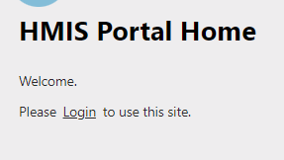
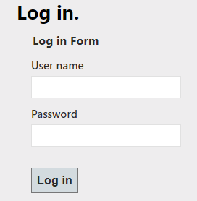
Logging Into the PIT Database
Your login information is your HMIS username and password.
If you do not have an HMIS username and password, but participated in the HIC/PIT last year, your username and password from last year is still the same
If you don’t have a username and password, or you don’t remember your info, please email help@nutmegit.com to get your account set up
Think Change • Be Change • Lead Change

Slide 14
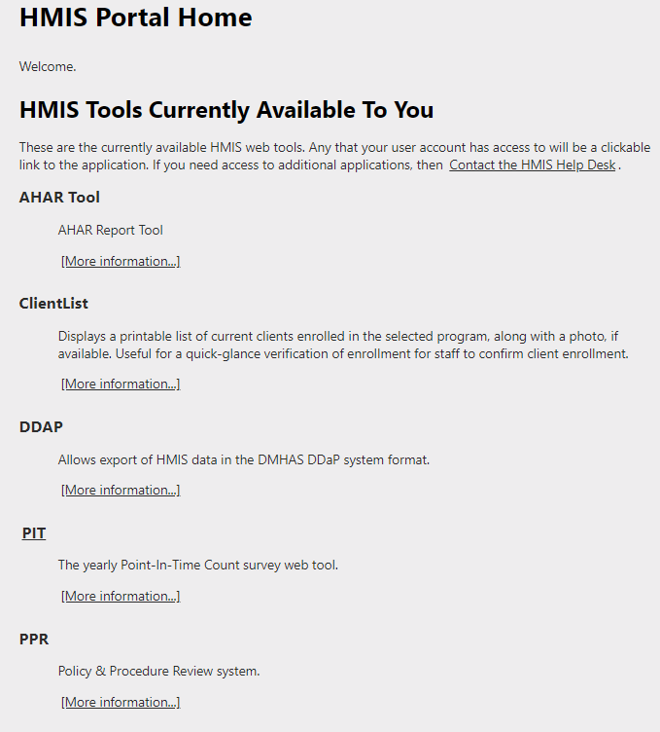
Logging Into the PIT Database
Once you log in, find the option on the list named “PIT” and click the word PIT
Think Change • Be Change • Lead Change

Slide 15
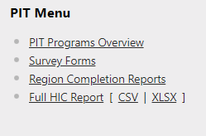
Logging Into the PIT Database
Then you will click on PIT Programs Overview on the Right side of your Screen
Think Change • Be Change • Lead Change

Slide 16
Logging Into the PIT Database
This will bring you to your project list
To enter the screen to validate/update your HIC information, simply click “edit” under the “Bed Count” heading on your screen
Think Change • Be Change • Lead Change

Slide 17
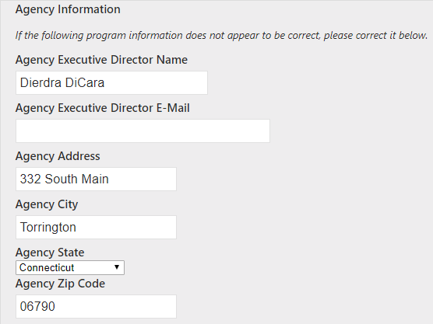
Reviewing Data in the PIT Database
Now you can review/update your agency headquarters address and executive director information
(Thank you to FISH in Torrington, we’re using you as a demo project again this year!)
Think Change • Be Change • Lead Change

Slide 18
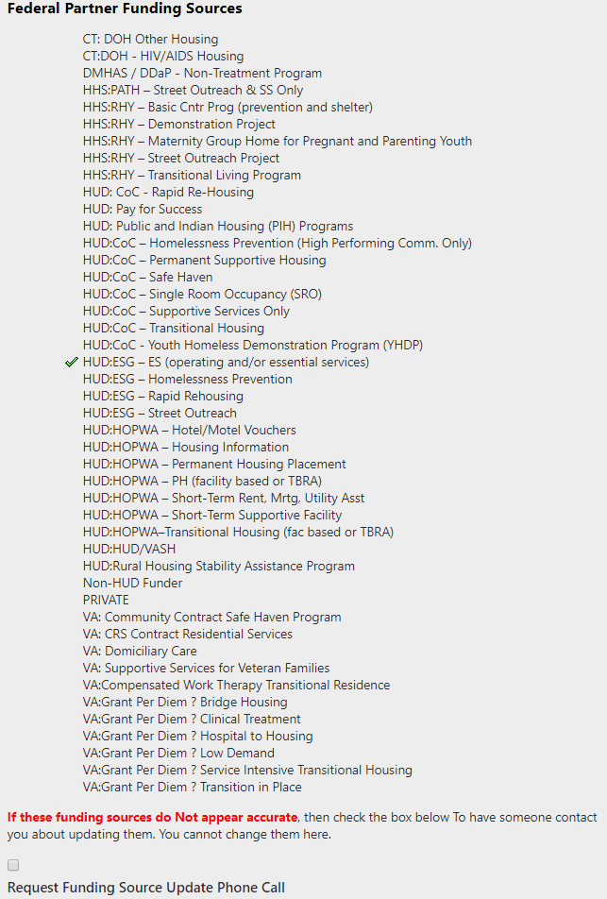
Reviewing Data in the PIT Database
The next part is the Federal Funding Source section
You cannot change this data here directly
If you have to make changes, you will check the “Request Funding Source Update Phone Call” box at the bottom of the list and someone from Nutmeg will contact you to discuss the updates needed
Think Change • Be Change • Lead Change

Slide 19
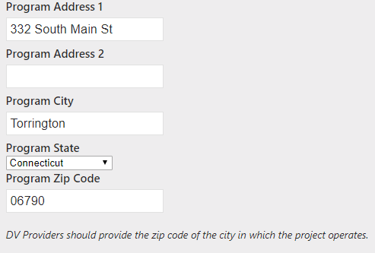
Reviewing Data in the PIT Database
Next you will need to confirm or update the address at which your project operates
If the project is a scattered site project, use the location in which the majority of the project’s clients are housed
Tenant-Based scattered site projects are only required to complete the zip code based on the where the majority of the clients are housed and may use the administrative address for the remaining address fields
Think Change • Be Change • Lead Change

Slide 20
Reviewing Data in the PIT Database
Next you will need to confirm your program info
Inventory Type is either CURRENT or UNDER DEVELOPMENT—There is no longer a “new” category
Housing Type is either Site-Based-Single Site; Site-Based-Clustered Multiple Sites; or Tenant Based/Scattered Site
There is only one Target Population Field and that is for DV or HIV serving projects
Think Change • Be Change • Lead Change

Slide 21
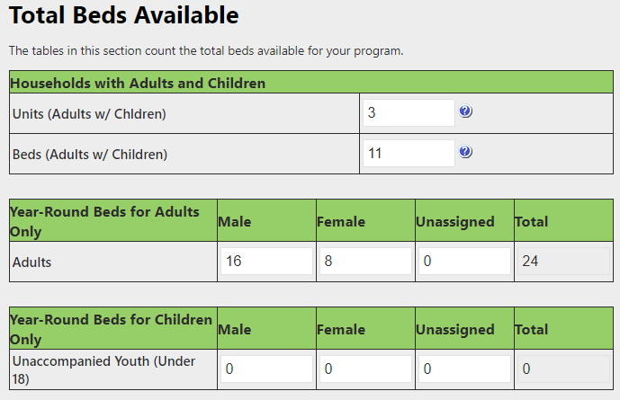
Reviewing Data in the PIT Database
Now you will need to check the values for your units and beds
If your data is not correct, you will not be able to change it here—you need to fill out the bed change form as mentioned earlier and send it to ctboscoc@gmail.com or Kadian@shworks.org
Think Change • Be Change • Lead Change

Slide 22
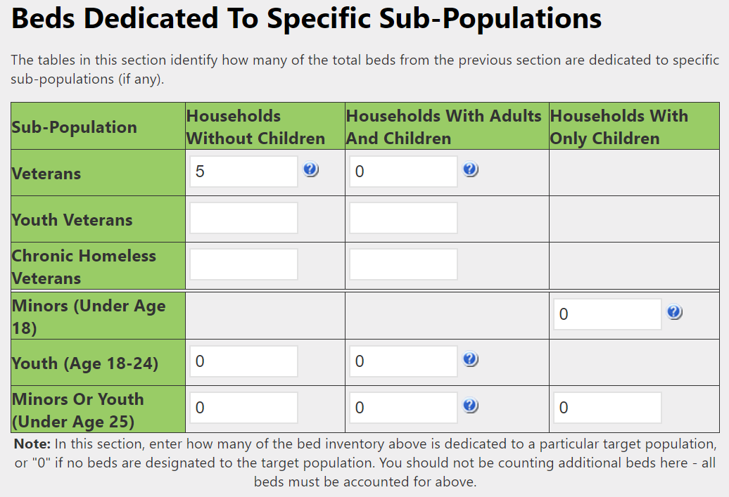
Reviewing Data in the PIT Database
Dedicated Subpopulation Beds are next
These are a subset of your overall bed totals
These specific sub-population tables are new this year
It’s possible your beds are not dedicated to any of these sub populations and you just need to confirm that 0 appears in all the boxes
Again, if your data is not correct, you will not be able to change it here—you need to fill out the bed change form as mentioned earlier and send it to ctboscoc@gmail.com or Kadian@shworks.org
Think Change • Be Change • Lead Change

Slide 23
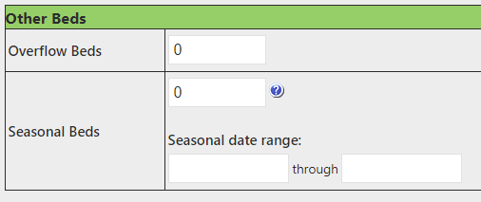
Reviewing Data in the PIT Database
Overflow and Seasonal Bed section applies just to Emergency Shelters
Overflow beds are beds available on an ad hoc or temporary basis during the year in response to demand that exceeds planned capacity
Seasonal beds are not available year-round, but are available on a planned basis with set start and end dates during an anticipated period of higher demand
Again, if your data is not correct, you will not be able to change it here—you need to fill out the bed change form as mentioned earlier and send it to ctboscoc@gmail.com or Kadian@shworks.org
Think Change • Be Change • Lead Change

Slide 24
Reviewing Data in the PIT Database
Finally, you will need to check the box indicating that you verified the data and click Save
Even if you have bed changes, you should still click this box!
Completion rates are determined by the selection of this checkbox and as long as you’ve submitted your bed change form and verified or updated the remaining data, you’ve done your due diligence!
Think Change • Be Change • Lead Change

Slide 25
Before we start the demonstration…
Our Contact Information
Linda Casey
Director of HMIS and Strategic Analysis
(860) 721-7876 x 110
lcasey@cceh.org
Mike Apotsos
Research Analyst
(860) 721-7876 x 114
mapotsos@cceh.org
Jim Bombaci
VP of Operations
(860) 256-4822 x716 help@nutmegit.com
Think Change • Be Change • Lead Change

