Slide 1

Connecticut Outreach Training: National Trends & Local Practice Strategies
May 30, 2018
Andrea White
awhite@housinginnovations.us

Slide 2
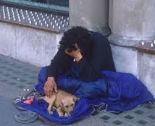
Agenda
Welcome & Introductions
National Service Trends & Policy Context
Engagement & Housing-Focused Services
Other Program Design & Practice Issues
Helpful Resources

Slide 3

Why do you do this work?
Divide into pairs and spend a few minutes telling your partner a homeless outreach success story.

Slide 4

Learning Objectives
Increase knowledge and skills in the following areas:
National Context
National trends on homeless outreach and coordination of homeless services
National policies that are driving changes to how communities are evaluated on outreach performance and how performance impacts funding for homeless programs
Understanding HUD Systems Performance Measures and CT outcomes related to outreach

Slide 5

Learning Objectives (2)
Increase knowledge and skills in the following areas:
Engagement & Housing Focused Services
Using assertive, low-barrier, culturally competent and trauma-informed engagement strategies
Helping clients to build motivation for change
Effectively engaging clients who are reluctant to engage and/or accept housing
Effectively supporting clients as they transition from outreach services to housing
Effective strategies to engage, shelter and house different populations (people with pets, youth/young adults, families, people with psychiatric symptoms and/or medical needs, active substance users
Providing effective services when housing is not immediately available

Slide 6
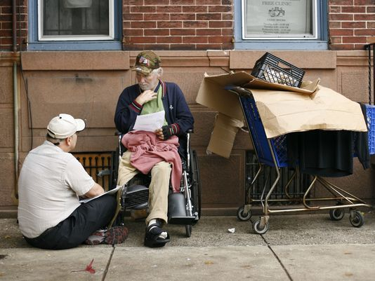
Learning Objectives (3)
Increase knowledge and skills in the following areas:
Other Program Design & Practice Issues
Conducting street outreach in a manner that supports client and staff safety, including working with people about whom you may feel fearful
Ensuring an outreach strategy across a large geographic area that coordinates with community partners to identify unsheltered people, including those who may not wish to be found, and establishes predictable times and locations where outreach workers are accessible
Documenting services when working outside and/or with people who cannot tolerate long forms

Slide 7
National Context

Slide 8

HUD/HEARTH Performance Measures
Length of time persons remain homeless – avg and median LOS (excludes outreach)
The extent to which persons who exit to permanent housing return to homelessness (delineates outreach)
Number of homeless persons – PIT and Annual Counts (PIT delineates unsheltered, Annual excludes outreach)
Jobs and income growth for homeless persons in CoC funded projects (no outreach projects)
Number of people who become homeless for the first time (excludes outreach)
Number of successful housing placements (delineates outreach)

Slide 10

National Service Trends & HUD Policy Priorities
Ending homelessness for all persons
  Target resources to highest needs/longest homelessness
  Engage and effectively serve all, including unsheltered
Creating a systemic response to homelessness
  Measure systems performance to determine effectiveness
  Use Coordinated Entry to provide assistance quickly, promote choice, ensure transparency & target resources
Notes:
Based on 2017 NOFA

Slide 11

National Service Trends & HUD Policy Priorities (2)
Strategically allocate resources
  Evaluate cost and outcome data
  Shift investments to improve performance and better align with identified needs
  Maximize use of mainstream resources
  Use a Housing First approach
  Eliminate preconditions & service requirements
  Prioritize rapid placement/stabilization
  Engage landlords
  Adopt client-centered practices
Notes:
Based on 2017 NOFA

Slide 12

Street Outreach Lessons Learned (SAMHSA)
A systematic, documented approach.
Consistent documentation of outreach efforts decreases the likelihood of overlooking those most in need & service duplication
A systematic approach allows faster access to a wider variety of targeted and mainstream programs.
Collaboration with nontraditional partners.
Goal: identify and target people experiencing/at-risk of homelessness and connect them with housing and services.
law enforcement, jails/prisons, hospital and other health/behavioral care and insurance providers
Provide supports upon exit to prevent homelessness/quickly re-house
https://www.usich.gov/resources/uploads/asset_library/Outreach_and_Engagement_Fact_Sheet_SAMHSA_USICH.pdf

Slide 13

Street Outreach Lessons Learned (SAMHSA -2)
Warm hand-offs.
Leverage outreach workers deep ties
Ensure gradual, warm handoff to housing and service providers
Outreach workers visit people in their housing for the first few weeks after move-in to reinforce the transition & provide support to the individual & their providers
https://www.usich.gov/resources/uploads/asset_library/Outreach_and_Engagement_Fact_Sheet_SAMHSA_USICH.pdf

Slide 14
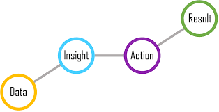
Street Outreach Lessons Learned (SAMHSA -3)
High quality data & data sharing
All outreach contacts recorded & permanent housing offers & placements tracked & monitored (e.g. using HMIS and by-name lists)
High quality & complete data at the person level enables better monitoring of individuals’ progress & accountability for identifying & quickly helping every individual
MOU’s/data sharing agreements enable identification of people with the highest needs from multiple systems and programs
https://www.usich.gov/resources/uploads/asset_library/Outreach_and_Engagement_Fact_Sheet_SAMHSA_USICH.pdf

Slide 15
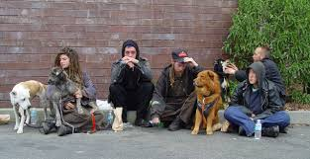
Street Outreach Lessons Learned (SAMHSA -4)
Training on evidence-based practices.
Trauma-Informed Care, Motivational Interviewing, and Critical Time Intervention
Diversity of approach.
For example, using social media can be particularly effective in reaching youth experiencing homelessness.
https://www.usich.gov/resources/uploads/asset_library/Outreach_and_Engagement_Fact_Sheet_SAMHSA_USICH.pdf

Slide 16
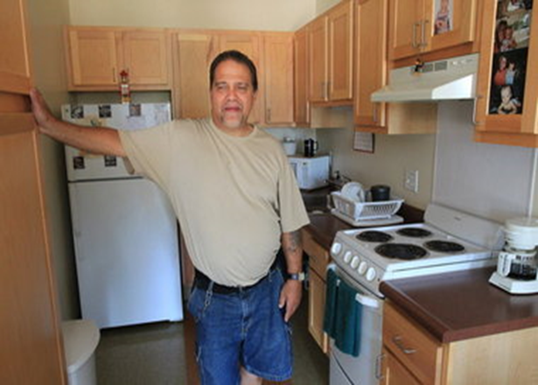
Focus on resolving housing crisis and meeting basic needs
Assist people to access housing as quickly as possible using a housing first philosophy
Focus on housing plan and stability
It is not enough for people to get housing; they have to be able to keep it

Slide 17

Working with People with High Needs
Work with people with high needs
This may include people with mental illness, substance abuse disorders, trauma, severe medical issues and cognitive impairments and combinations of these conditions
Safety and predictability assist people to organize and problem solve.
It is important to identify what is negotiable and what is not
  Rent is not negotiable but the amount of money coming in may be.

Slide 18

Engagement

Slide 19

Homelessness
  Each person’s story is different
  Focused on survival
    Time is structured by getting food, water, money, a place to sleep
    People often have to give up pieces of themselves to secure needed resources
    People often report being invisible and requiring extremes to get attention
    Follow simple rules in order to remain in place
  Accustomed to lack of basic services
    May not have place to bathe or even wash their face
    Focused on securing limited possessions
    May be accustomed to “rough justice”

Slide 20

Homelessness -2
      Low expectations to receive help
          If response is not immediate may never get what is needed
          May have had a role on the streets that is likely to continue in shelter/housing
      May have an addiction that interferes with curfews, ability to take directions, physical issues and sleep
      May have a mental illness that interferes with trust, sleep, ability to take direction and organization
      May have a cognitive issue that interferes with ability to follow directions, organization, confusion and memory
      Difficulty with trust and reluctant to hope

Slide 21

Barriers to Engagement
Barriers
Causes
  Severe psychosis – delusions and hallucinations
  Inebriation
  Disorganization
  Mistrust of worker
  Moving locations
  Not showing up
  Not following through
  Irritability/agitation
  Others?
  Mental Illness
  Substance Misuse
  Past Trauma
  Post Traumatic Stress Disorder (PTSD)
  Bad experiences with workers in the past
  Traumatic Brain Injuries
  Depression
  Cognitive Impairments
  Others?

Slide 22

Engagement
Engagement begins the first time you meet a person.
Engagement is a way of being with a person and sets the tone for all future interactions.
Listen to each persons story, what their concerns are, what they want.
Evaluate each person, assessing what they tell us, where they live, how they interact with their surroundings.
Seek information from HMIS, the CAN, the police, EMS, and homeless and mainstream service providers that have had interactions with each person.

Slide 23

Observation
Pay attention to people’s patterns
When are they most amenable to having a conversation?
What do people like to do?
What works to calm people?
What do they respond to?
What does out of control look like?
What does behavior possibly indicate for housing issues?
What motivates them?
What needs to be documented and/or shared with other teams/staff?

Slide 24

The Relationship
  Engage and establish a working relationship.
  Be yourself. People know if you are being authentic and genuine.
  Identify what each person wants and what they are feeling.
  Small goals are appropriate for the start.
  As small things are achieved, confidence and trust grows.
  Building motivation for a home and connecting it to the person’s goals is the worker’s focus during engagement.

Slide 25

Working Together
What services can you provide?
Everything from food to hygiene supplies to getting documents provides an opportunity to develop a relationship.
Offering people some choice with food and remembering preferences helps people believe needs may be met.
As much as possible, giving several hygiene supplies (such as underwear) allows people not to have to ask (or scream) every time they need something.
Accompanying someone to get documents often ensures success and can build hope and confidence as well as teach skills.

Slide 26

Core Practices in Engagement
Be patient, consistent reliable, supportive
Explain and re-explain (and re-explain) your role
LISTEN for what each person is interested in, wants and needs
Find something to work on together
Present housing as a way to get wants, needs and goals met
Go for comfort and/or relief
Keep showing up

Slide 27

What Engagement Strategies Would You Use?
Mary refuses to speak to you, and you suspect she is experiencing paranoid symptoms.
Every time you see Roberto he is drunk and unable to engage in a productive discussion.
Andy is friendly and eager to see you but refuses to pursue housing or make any changes.

Slide 28

Engagement Tasks
  Provide Resources to Meet Basic Needs & Increase Comfort
  Educate on Housing Options and Expectations of Each
  Identify Goals and Preferences
  Assess Housing and Homelessness History
  Connect to Income
  Gather Documents
  Assist with Housing Search
  Connect to Resources that Support Housing Stabilization – Treatment and Supports
  Develop a Housing Stabilization Plan
  Teach Tenancy Skills
  Obtain consent to talk with housing provider
Notes:
Talk Housing
What will it take?
What are the options?
What are the requirements?
What are the rights?
What are the responsibilities?
How does it connect to what Veterans want?

Slide 29

Trauma & Homelessness
Research has shown that individuals who are homeless are likely to have experienced some form of previous trauma.
Homelessness is a traumatic experience – stressful, dehumanizing, dangerous.
Being homeless increases the risk of further victimization.
Trauma Informed Care:
Places specific focus on the impact that trauma and violence have had on clients
Helps staff to understand how trauma impacts clients, including how clients might react to triggering situations
Helps staff to develop more effective responses to those reactions

Slide 30

Impacts of Trauma
Trauma can interfere with a person’s:
sense of safety
ability to self-regulate
perception of control and self-efficacy
interpersonal relationships
Share an example of how trauma has impacted a client’s response to a situation.

Slide 31
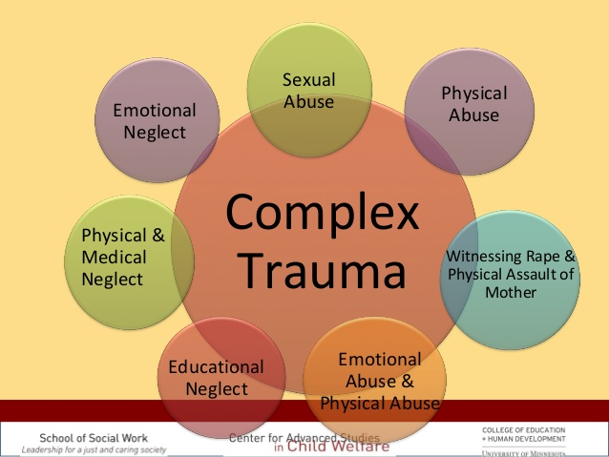
Trauma and Stress
  People may avoid stimuli that trigger thoughts, feelings or memories of the trauma
  Some people experience negative thoughts or feelings and may be unable to recall features of the trauma
  May have negative thoughts about themselves and the world around them
  Over-react to current situations based on past trauma experiences
  Blame themselves or others for what happened to them
  May have an extremely flat affect
  Feel isolated
  Not as interested in activities and a hard time having a positive affect.

Slide 32

Trauma
  You may also see:
    Irritability or aggression
    Risky or destructive behavior
    Hypervigilance
    Heightened startle reaction
    Difficulty concentrating
    Difficulty sleeping
    Over-reactions to situations that bring on flashbacks
  The symptoms persist and you may note difficulties in functioning and difficulty connecting
  Homelessness itself may result in psychological trauma
  Trauma includes three components: Events, Experience and Effects
  We may need to treat everyone seen in homeless services as trauma survivors

Slide 33

Trauma Informed Care - Strategies
Emphasize safety
Be predictable
Be aware of potential triggers and avoid re-traumatization
Create opportunities to rebuild control – emphasize client choice
Establish clear roles and boundaries
Assist clients to identify their strengths and build skills

Slide 34
Identifying unsheltered people

Slide 35

Locating Unsheltered People
Visit targeted neighborhoods at different times (especially very early in the morning).
Identify partners who can help identify people (clients, jails, prisons, hospitals, police, EMS, libraries, schools, local government, DSS, child welfare, churches, VA, park staff, others?).
Have a schedule to reach out regularly to partners rather than relying only on referrals.
Ensure your strategy covers your entire geographic area.
For locations with a lot of unsheltered people, establish predictable times and locations where outreach workers are accessible.

Slide 36

Locating Homeless Youth
Ask homeless youth where they hang out.
Employ young people.
Publicize resources on social media.
Connect via text and/or messaging apps.
Outreach regularly to local LGBTQIA organizations, schools, & juvenile law enforcement.
Other strategies?

Slide 37


Locating Homeless Families
Connect with domestic violence organizations and churches.
Develop relationships with staff at low cost motels and school social workers.
Watch for cars with lots of stuff.
Visit places at night or early morning where people might park and sleep.
Be mindful of fear of child welfare system involvement.
Other strategies?

Slide 38
Building Motivation for Housing

Slide 39

Ambivalence about Housing
  Brings up past experience of losing housing
  Loss of role and predictable routine
  $$
  Uncomfortable inside, in quiet places
  Fear of failing again
  Leaving friends and significant others behind
  Lonely
  Responsibilities
  Never had a lease – not confident
  Others?
  Giving people time and opportunity to process these feelings is a key part of the preparation to accept housing.

Slide 40


Understand Housing and Homeless History
Housing History –
  Places lived, with whom (last 5 years)
  Experience as a leaseholder
  Roles and responsibilities
  What worked
  What didn’t
Homelessness History -
  Cause of initial episode
  Length of time homeless
  Places stayed
  Routine
  Supports

Slide 41

Talk Housing
What are the options?
What are the eligibility requirements?
What are the rights?
What are the responsibilities?
How does it connect to what people want?

Slide 42

Housing Planning Discussions
Location
Access to Transportation
Proximity to Significant Others
Proximity to Services
Pets
Ideal v. Acceptable, Negotiable/Non-Negotiable
Unit Size and Housing Density
Attached: Housing Planning Discussion Framework
Notes:
Preferences
Identify what is negotiable and what is not
Let people dream a bit – what is their ideal, what do they have now, what would they accept
See option available as step towards goal
Background Problems
Identify what is different now from when issue occurred
Plan for not happening again
Line up supports
Practice discussing with potential landlords

Slide 43
Understanding Housing Preferences

Slide 44

Tenant Responsibilities a Lease/Tenancy
Allow other tenants the peaceful enjoyment of homes
Make required rent payment on time
Keep unit free of health and safety hazards
Only allow people on the lease to live there
No criminal activity in unit, common areas or grounds
Keep utilities current and paid

Slide 45


Motivating Change
Recognize success
Keep focus moving forward
What are the costs/benefits?
Common Understanding
Several possible directions
Notes:
Driving imperfect metaphor but you’re the driving instructor, you want to learn something about the student before handing over the keys
First curve passed
Ensure a common understanding
Develop several paths to desired change
Weigh cost/benefits of components of each
Look back for competencies to build confidence
Look forward for hope and inspiration
Lay the foundation for future planning
Accept behavior may not fully change but outcome can be different

Slide 46


Motivation
Behavior-specific (people have different motivations around different issues)
Person-specific (each person is motivated to change by unique factors)
Compliance does not equal change
Change that occurs because of external pressure tends to be short lived
More that someone “owns” (internalizes) the reasons for change, the more likely change will endure
Notes:
Motivation is not a fixed trait; like eye or hair color
What do you think can influence motivation

Slide 47

Building Motivation for Change
Change is always hard and motivation gets you through it – must feel confident and important to change
Motivation fluctuates from one time and situation to another; not a fixed trait
Motivation can be influenced by outside influence; it does not reside solely in the person

Slide 48
Creating a Platform for Change:
Hope, Meaning and Confidence
HOPE
How can you change if you don’t think it is possible?
MEANING
How can you change if you don’t think it is important?
CONFIDENCE
How can you change if you don’t think you can do it?

Slide 49

Core Theories of Motivation Interviewing
Ambivalence about behavior change is normal.
Ambivalence can be resolved by working with person’s intrinsic motivations and values.
The alliance between staff and the client is a collaborative partnership to which each brings important expertise.
An empathic, supportive, yet directive, counseling style provides conditions under which change can occur.
Direct argument and aggressive confrontation tend to increase defensiveness and reduce the likelihood of behavioral change.

Slide 50

Support Self-Efficacy
  Belief that change is possible is important motivator
  There is hope in the range of solutions available
  Person is responsible for choosing and carrying out actions to change (and gets the credit!)
  Person has been successful – listen to the narrative
  What is the meaning of the change? Why is it important in getting what the person wants?
  Build confidence based on past skills and successes
          “Can we talk about when you were applying for housing? You were able to manage the landlord interviews really well.”

Slide 51
Decisional Balance Sheet
Pros and Cons of Staying Homeless
Pros and Cons of Getting a home
+ | -
+ | -

Slide 52
Stages of Change
Stage | Relationship to Problem Behavior | Staff Tasks
Pre-Contemplation | No awareness of problem | Ask q’s/ raise awareness of obstacles to goals
Contemplation | Aware of problem & considering change | Pros & cons of changing/not
Preparation | Making plans for how/when to change | Options: strategies, supports & services
Action | Changing behavior | Support/relapse prevention
Maintenance | Change sustained for 3-6 months | New goals
Relapse | Return to problem behavior | Assess stage and intervene accordingly

Slide 53
Partner Discussions
Think about at least one outreach client you are currently working with. Turn to someone seated next to you and each describe how you are working to build motivation build motivation for to come inside.
What is working and what is not working?
What does the person want?
What is interfering with them meeting this goal?

Slide 54
Developing a Housing Plan

Slide 55

Role:
Working with Coordinated Entry (CAN), Case Managers, & Other Teams
Each person will be evaluated for eligibility, need and vulnerability by the CAN
Some clients will get housing with CAN assistance
The behavior observed on the streets can inform the assessment and plan to stabilize in housing
Outreach staff can assist by
  reminding of appointments
  assisting to gather documentation
  building motivation for housing
  supporting employment/job search
  sharing information and observations with CAN and other case managers/housing navigators
  using the relationship for a warm handoff with the housing case manager
  providing consultation on behaviors that surface in housing search
  provide support as residents prepare for the transition

Slide 56

Coordinating with Partners to get People Housing
How do you know who is doing what?
How do you decide what are the most critical tasks to expedite housing?
How do you determine who is taking the lead on each task?
How do you measure progress towards housing?
How do you hold each other accountable?

Slide 57
Adjusting to the home: establishing a schedule
Outreach staff understand the person’s schedule when they were homeless.
Work or other predictable activities bring structure and purpose to peoples’ lives which helps them to stabilize in the community.

Slide 58

Transition to Housing
New start
Opportunity for change
Involve both loss and gain
Often stressful
Can increase symptoms
Unknown/uncertainty increases anxiety
Require a new daily schedule
Trigger fears of failure
Require support

Slide 59

Housing Plan Overview
Guides the work with tenants.
Evolves over time.
Focused on what matters to tenant.
Based on tenant goals
Requires on-going assessment
Informed by discussions with tenant team, informal supports & community resources.
Provides the structure to reach goals &overcome barriers.

Slide 60

Getting Started
  Begin with basic needs:
    Transportation, money, food, pain relief
  Focus on simple needs:
  Develops trust
  Provides opportunity to define roles
  Allows tenant to talk about experiences
  Sets tone & structure for future work

Slide 61

Progressing
  Progress to more complicated tasks:
  Housing, family, connections to services, employment
  Connect short-term work to dreams and aspirations.

Slide 62

Assessment
  Process not an event.
  Requires trust that offering information will lead to needed services/resources.
  Allow the information to unfold over time.
  As each client experiences challenges and progress, the assessment will deepen.
  The work as an outreach worker provides unique information about how each person lives, what their dreams are, who their connections are, how they look when decompensated

Slide 63
Assessment Domains
  Tenant Information
  Housing and Homelessness History and Information
  Life Skills
  Employment and Education
  Health
  Behavioral Health, Substance Use and Trauma
  Financial Resources and Obligations
  Legal Involvement
  Services Resources
  Natural Supports
  Interests and Hobbies
  Strengths and Barriers to Accessing resources
  Summary

Slide 64
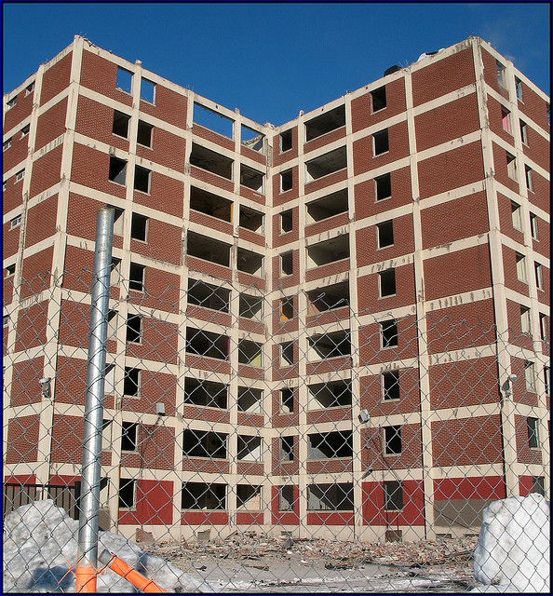
Assess Housing and Homeless History
Past housing & homeless experiences
Current housing goals
Housing likes/dislikes
Barriers to access and sustainability
Housing dreams
Notes:
Ability to complete paperwork, view apartments, handle interviews

Slide 65
Financial Needs/Requirements
Upfront cash needs
Deposits
First and Last
Utility deposit
Furnishings
Ongoing cash requirements
Utility cost above ‘utility allowance’
Tenant rent – minimum rent
Other living expenses
Moving costs
Security

Slide 66

“The plan provides hope and fosters a sense of accomplishment by breaking a seemingly over-whelming journey into manageable steps both for the provider and the person being served.”
Tandora, J. Miller, M., Davidson L (2012)

Slide 67
Developing a Housing Planning
Limit the areas of intervention
Focus on the most pressing needs that impact housing access & retention
Relate all interventions to long term goals
Usually not a linear process
Help people move away from crisis-driven lives

Slide 68
Focus Areas for Housing Plan
Focus on Safety
Goal setting by person in partnership with the worker
Connection to high quality sustainable services and supports
Harm Reduction approach
Focus on Self Sufficiency & Stability
Use person’s goals and housing focus
Help assume role and meet expectations of tenancy and community
Teach rather than do
Strong Expectation that Person becomes Integral Part of Community
Considers purpose and activity
Transition and recovery of valued life roles

Slide 69

Goal Setting Strategies
What does tenant want from life?
  Identify values
  Clarify what is important.
  Let people dream– What does your ideal future look like?
  Identify what is negotiable/non-negotiable- What do you have now? What would you accept?
  See options available as steps toward a larger goal.

Slide 70
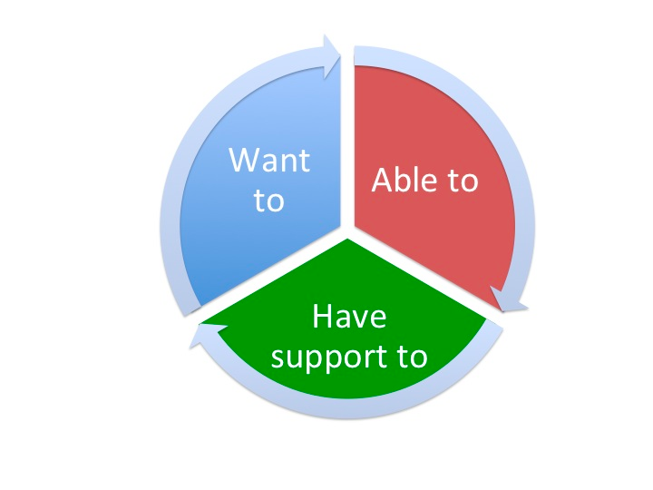
What if someone says s/he has no goals?
  Factors that impede goal identification:
  Homelessness limits ability to think long-term
  Crisis requires focus on survival.
  Loss of control over one’s life makes change difficult.
  Past failure makes people feel unprepared.
  Psychiatric symptoms can disrupt cognitive abilities.

Slide 71

Surfacing goals
  Start with immediate needs & build.
  Questions that can help:
  What would make you more
  comfortable right now?
  What would help to make your
  life better next week?
  How would you like your life to be different 6 months from now?
  How much money do you need to live comfortably in housing?

Slide 72

Goal Setting: Peter
  Peter has been living mostly at the bus station for about a year. He talks to the outreach workers to get food or toiletries. He recently asked for a ride to social services. He has a relationship with his family but hasn’t seen them in a couple of years. He probably has a psychiatry disability but doesn’t talk about it and won’t see a doctor. Peter pretty much keeps to himself. He tells you he is fine, he wants to be left alone and doesn’t have any goals.
  What questions you might ask Peter to help learn about his goals.

Slide 73
What do you work on while talking housing
Increasing safety
Decreasing discomfort
Increasing income
Getting document ready
Identifying short-term and long-term goals
Reducing harm from substance use & other troubling behaviors
Connecting to services and supports
Building skills (tenancy, relationship, self-care, evaluating services and navigating service systems)
Finding structure and purpose
Recovery of valued life roles
Building hope and confidence

Slide 74
Evaluating & Updating the Plan
At least every 6 months:
Identify barriers.
Re-assess priorities.
Clarify preferences.
Refresh goals.
Document steps achieved.
Identify adjustments needed to supports.
Achievements build CONFIDENCE and COMPETENCE.

Slide 75
Small Group Discussions
case studies

Slide 76

Barry
Barry loves his dog Butch, and Butch is very protective, particularly when Barry nods out. Barry used to work as a truck driver, but had to quit because of a back injury. He gets enough in SSD that he could afford a small place, but he says he likes living outside and would rather spend the money on heroin. He says Doctors just don’t get how much pain he is in. He won’t go anywhere without Butch.

Slide 77
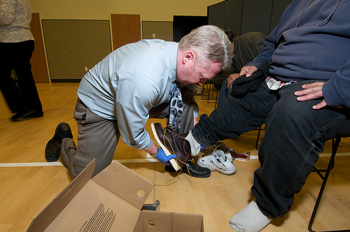
Jake
Jake has uncontrolled diabetes. The outreach team has tried everything to get him stable. They connected him to the clinic and visit him daily to ensure he takes his medication. He is not always there and misses appointments. The other guys offer to hold the medication. The team doesn’t trust that. He tried a shelter but lasted two days. The team knows he is drinking; he denies it and will not discuss treatment. He says he will get his sugar right when he’s in housing. There is concern that he will die.

Slide 78
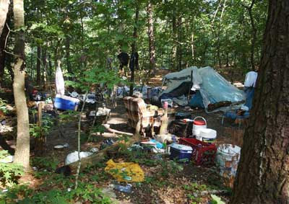
Joyce
Joyce lives in an encampment with a small group of men. ‘For protection’, she says. It looks like she is exchanging sex for money or drugs/alcohol. She admits she likes pot and drink. She laughs, says ‘they are expensive.’ She has no intention of giving up. She gives her check to the men in her camp. The team is worried. She is connected to the men but it appears they are taking advantage of her. Her thinking seems off. They may be physically threatening. Joyce often has bruises. She laughs when asked about them and says ‘not enough money’.

Slide 79
Questions to Explore in Small Groups
What are some of this clients’ strengths?
What are some of the risks s/he faces?
What is the person asking for?
How might you help build motivation for housing?
What can you work on together?

Slide 80
Defining & Measuring Success

Slide 81

Measuring success
How long does it take to move people who are document ready into housing?
How many people moved into housing last year?
How many people are you going to move into housing this year?
Of those who moved into housing, how many return to homelessness?

Slide 82
Using housing targets to focus outreach work
Establishing monthly or quarterly housing targets helps outreach teams:
  Commit to a common goal
  Focus on housing
  Set priorities for which work is most important
  Measure and celebrate success

Slide 83

Using housing targets to focus outreach work - 2
Determine how many participants were housed last year.
Set this year’s target a little higher (unless housing situation has gotten much worse).
Divide annual goal into 4 to establish quarterly targets (or 12 for monthly targets).
Decide each quarter which participants you are going to focus on housing in the coming quarter.
Plan for the unexpected by focusing on twice as many people (e.g., if quarterly housing target is 4 placements, focus on 8 clients.)
Determine which tasks are most critical to get done for each targeted participant.

Slide 84

Using housing targets to focus outreach work - 3
Determine who is responsible for each task and set a target date for each.
Keep track of tasks, target and completion dates (e.g., in a spreadsheet).
Discuss the tracking tool regularly in supervision and team meetings.
Take a team approach to problem solving when you encounter obstacles or don’t hit your target.
Focus on what you can control not on things outside of your control.
Adjust targets as necessary (up and down).
Acknowledge each person’s contributions and celebrate successes – big and small!

Slide 85
Safety in the field

Slide 86

Safety: Core Components
    Remember: we are in their space
    Be aware of what your role is and limits
    Visit negotiated in advance if possible: Be clear about conditions (intoxicated, guests, firearms)
    Precautions and following safety policy
    Start slowly keeping small promises
    Be clear about your role
    If risk /crisis is assessed get help: have a back up plan
    Use supervisor and team: ask someone to go with you
    Always let the team know where you are and when you are expected to return – check in

Slide 87
Prevention: Preparing for Outreach
Before outreach
Conduct a thorough record review, if available.
Learn about the neighborhood (confer w/local law enforcement)
Schedule outreach in pairs whenever possible.
Be sure someone at the office knows your field schedule including locations and times.
Update them before you change plans.

Slide 88

Warning Signs
Changes in: Behavior, relationships, use of services/ supports
Changes in income or living situation
HALT Hungry, Angry, Lonely, Tired
Presence of substance abuse, TBI, PTSD or psychiatric symptoms
Talking about not wanting to live or about hurting others or making threats
History of dangerous behavior
Plan and/or access to resources to do harm
Notes:
H.A.L.T. stands for Hungry, Angry, Lonely, and Tired. Each one of these four physical or emotional conditions, if not taken care of, leaves an individual vulnerable for relapse.

Slide 89

Defining Roles: Disruptive Behavior
There are many reasons a participant may be disruptive:
  Mental health issues, drug and alcohol use, trauma history, medical, brain injuries, cognitive issues
  Different people/agencies seeing this person and may have different perceptions and information
  Gather all the information and problem solve how to stop the behavior
  Ask for consult with the Mental Health, Substance Use, medical provider
  Offer alternatives for compliance

Slide 90

Field Safety Tips
Always have a way to communicate- charged phone.
Don’t approach if you feel unsafe.
Avoid approaching someone for the first time alone.
If alone, don’t approach a group, engage someone high risk, or enter a location that is not publicly visible.
Postpone, meet in a different location, or have a team member join.
Use your gut instincts.
Build good relationships with police and involve them when needed.
Schedule visits for early morning when less likely to be intoxicated

Slide 91
Resources for Safety
Ask another team member to accompany you
Always tell a team member where you will be and when you will return
A working vehicle
A charged cell phone
Good judgement and your gut
Coordinate with the CAN and/or police for back up if needed

Slide 92
Resources for People with Pets
Know the rights of your participants
    Emotional Support Animal
    Service Animal
    Therapy Animal
    Be compassionate
    Find Resources (see handout)

Slide 93

Wrap-up & Evaluations
Thanks for participating!

